Slide 1
CHD WITH DUCT DEPENDANT CIRCULATION
part i

Slide 2
REFERENCES:
Congenital heart diseases By IB Vijayalakshmi
PDA – Circulation article- Douglas J. Schneider and John W. Moore
Paediatric and child health;Presentation of coarctation of aorta in the neonates and infant with long and short term implication; Elsevier
Critical heart disease in infants and children Ross M.Ungerleider Elsevier
Park Paediatric cardiology
Moss Adams Heart disease
Perloff Clinical recognition of congenital heart diseaseBraunwald Heart disease Edition 12
Circulation article- recommendation of blood pressure determinants by sphygmomanometer
Clinical diagnosis of congenital heart disease ., M Satpathy
The Natural and Unnatural history of Congenital Heart disease Julien I.E. Hoffman

Slide 3
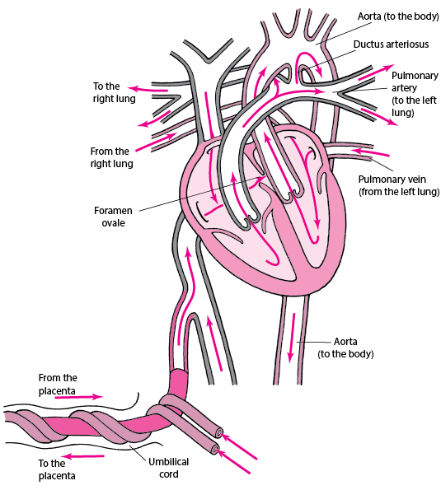
90%
FETAL CIRCULATION
Notes:
Fetal circulation – circulation in series
Deoxygenated -> internal iliac artery as 2 umblical artery/ blood is oxygenated in placenta and returned.
1)Blood is oxygenated in placenta and returned to fetus via the umblical vein.
2) The blood flow in umblical vein is split in liver; where 30% of blood flow is directed to direct shunt known as dv.
4)Highly oxygenated blood from dv(posterolateral jet) is directed to foramen ovale->la
5)Venous blood along with svc blood goes to Tv into RV.
6)As lung is inactive, most of the deoxygenated blood enters ductus arteriosus from pa into descending aorta distal to left sca.
7)Only small portion of blood enters the lung-deoxygenated blood Which enters la.
8) From the ascending aorta oxygen rich blood supplies coronaries,head and neck vessel and upper extremity.
9) Lower half of our body receives relatively desaturated blood.

Slide 4
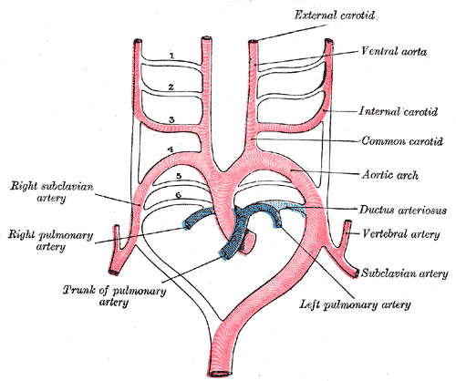

Slide 5
At First Breath -> After expansion of lung , PVR
Increased Pulmonary blood flow -> Increased blood flow across LA
Placenta removed
Flow of Blood through DV -> Decreased Venous return
RA pressure falls
Equalization of pressure
Flap of FO pushes against interatrial septum
Functional closure immediately
Anatomic closure occurs later via tissue prolifieration

Slide 6
DUCTUS ARTERIOSUS after Birth
PVR
Shunt Becomes Bidirectional
Decrease in Production of Prostaglandin E2
Increased metabolism by lung
Increased oxygen content in blood
Ductus arteriosus closes
Notes:
Functional closure by 96 hours
Anatomic closure by 2-3 weeks
Anything that increases PVR-> acidemia, hypoxia, polychytemia , lung disease – keeps ductus patent

Slide 7
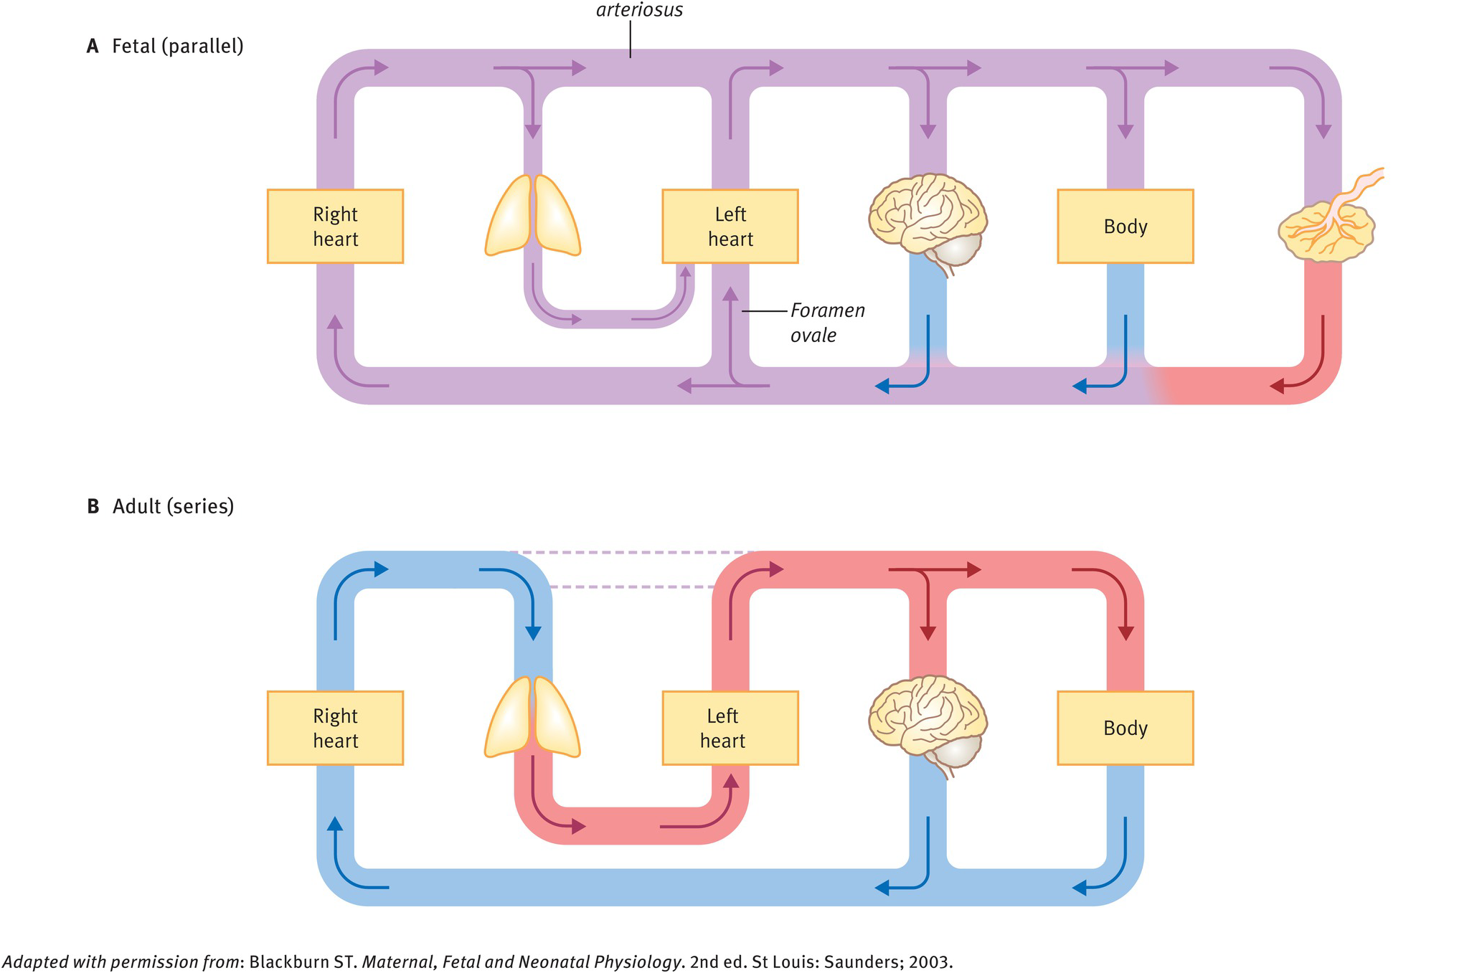
TRANSITIONAL CIRCULATION
Notes:
Parallel circulation → Series circulation

Slide 8
DUCT DEPENDANT PULMONARY CIRCULATION
DUCT DEPENDANT SYSTEMIC CIRCULATION
MIXING
1) Transposition of great arteries
1)Pulmonary atresia with or without VSD
2)Critical pulmonary stenosis
3)Tricuspid atresia
4)TOF-Severe Form
5)Ebstein anomaly of tricuspid valve
1)Critical Aortic stenosis
2)Coarctation of Aorta
3)Interruption of Aortic arch
4)Hypoplastic left heart syndrome
Notes:
Duct dependent lesions are special group of CHD with life threatening propensities.These defect are responsible for life threatening haemodyanamic effects. The two shunts PFO and PDA play a unique role since they do not have effective valve and depend on pressure of adjoining chambers or great artery for shunting of blood in either direction.

Slide 9
DUCT DEPENDENT SYSTEMIC CIRCULATION

Slide 10
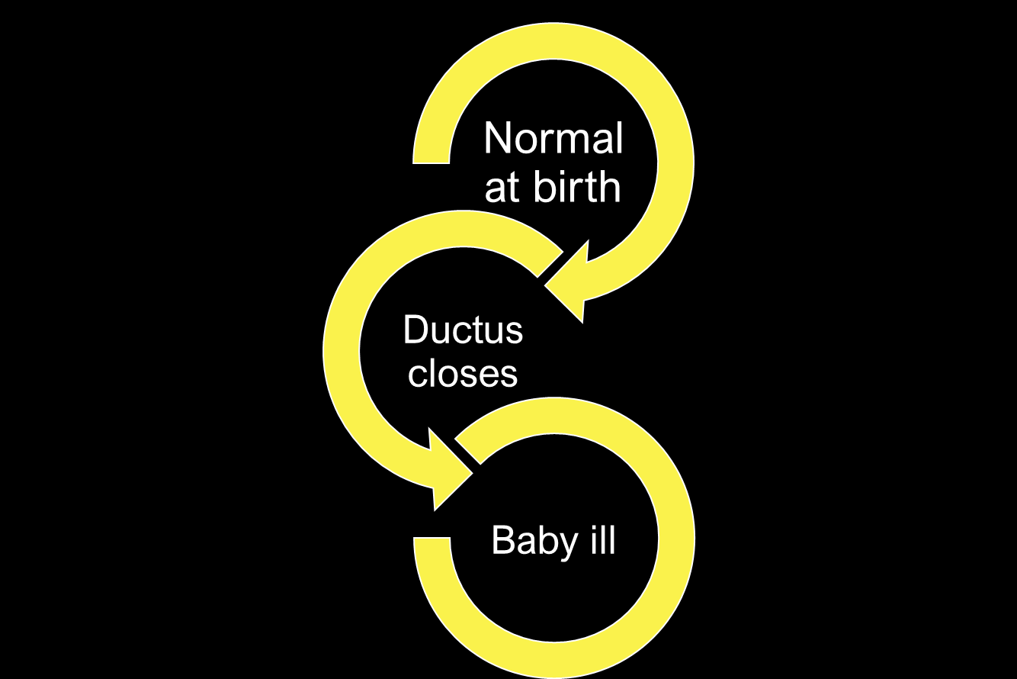

Slide 11
COARCTATION OF AORTA
4-8% of All CHD
Male : Female – 2:1
30% of Turner syndrome -> CoA
M/C -> Bicuspid aortic valve
Rubella syndrome association
Notes:
CONTRACTION, TIGHTENED AND PRESSED TOGETHER
DISTICT COARCTATION WITH PROMINENT LIMA
Bicuspid aortic valve may be present in 80% of Coa and valve may be stenotic or annulus hypoplastic.

Slide 12
Embryology
Thoracic CoA
Abnormal Development of Embryogenic Left Fourth and Sixth arch
Ductal Tissue theory
Migration of Ductal smooth muscle tissue into Periductal aorta
Coarctation Manifest after Ductal Tissue closure
Palliation with Pg E1 infusion
Haemodynamic Theory
Haemodynamic disturbances that cause reduced blood flow across Aortic arch

Slide 13
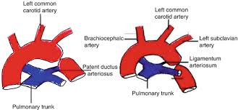
BONNET CLASSIFICATION
INFANTILE
ADULT
Notes:
INFANTILE: If there is severe obstruction to blood flow, haemodynamic stability may rely on flow through the patent ductus arteriosus (PDA)
ADULT: GOOD COLLATERALS DEVELOPED.

Slide 16
Associated anomalies
1) Taussig Bing Anomaly
2) TGA
VSD + LVOT OBSTRUTION
VSD
Perimembranous VSD
Malaligned VSD
LVOTO
Mitral valve Obstruction (Shone Complex)
Arch Hypoplasia
Muscular VSD
Abnormal Aortic valve
Notes:
Malaligned VSD- posterior septum deviation of conal septum causes LVOT

Slide 18
Berry aneurysm → 10% (connoy et al.,)

Slide 19
SYMPTOMATIC INFANTS
ASYMPTOMATIC CHILD
Notes:
Depending on the severity of obstruction to aortic flow, development of collateral circulation and associated heart defects the presentation of CoA may be anywhere from acute circulatory collapse to an incidental finding of absent or weak femoral pulses or asymptomatic hypertension at an older age. We will focus on the presentation in the neonatal period.

Slide 20
SYMPTOMATIC INFANTS
Reduced flow across Aorta(Arch hypoplasia/ LVOT obstruction)
Distal to CoA → Supplied By PDA
Good Blood Flow
No Pressure gradient
No Collateral development
Notes:
Before birth

Slide 21
ASYMPTOMATIC CHILD
In absence of Associated defects
Normal amount of Blood reaches isthmus
Gradient across CoA
Development of Collaterals
Tolerate DA closure well

Slide 22
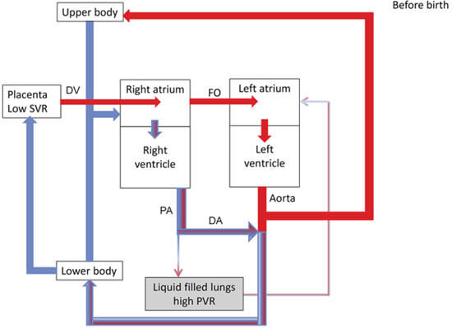
10%
90%
Notes:
Fetus – 10% of ventricular output traveses the aortic isthmus.

Slide 23
AFTER BIRTH
Notes:
After birth, with closure of foramen ovale and ductus arteriosus larger volume flow across stenotic atretic segment.
Thus important hemodyanamic disturbances occurs postnataly.

Slide 24
Notes:
Explanation for deteroriation after few days of life
Coarctation in juxta ductal position, so the space is added to the narrowed aorta by the ductus
After ductal obliteraltion, added lumen is lost and the aorta becomes severly obstructed. Although the severity of coarctation is unchanged

Slide 25
BEFORE DUCTAL CLOSURE +
CRITICAL Coa
Descending aorta supplied by RV via PDA
RV VOLUME OVERLOAD
Notes:
CoA show RVH in infants. Rather than LVH RVH on ECG is replaced by LVH by 2 years of age.

Slide 26
INFANTS
COA + DUCTAL CLOSURE
INCREASED LV AFTERLOAD
LVEDP,LAP,PAH
ABSENCE OF COMPENSATORY MECHANISM- IMMATURE MYOCARDIUM
CHF
DEATH- MODS
RENAL FAILURE, NECROTIZING ENTEROCOLTIS
SHOCK , ACIDOSIS – 8-10 DAYS
Notes:
catastrophic illness
absence of compensatory mechanism like sns and frank starling law
Neonate- systolic dysfunction
Adult- Both systolic and diastolic dysfunction

Slide 27
INFANTS
COA + DUCTAL CLOSURE
INCREASED LV AFTERLOAD
LVEDP,LAP,PAH
Increased shunting of Blood across Foramen Ovale
RA/RV overload
Notes:
Pressure overloaded right ventricle is volume overloaded now

Slide 28
Infant – can remain asymptomatic
1)Degree of narrowing not severe
2)Concomitatant development of collateral vessel over time
Notes:
They can present weeks or months later, with a subtle picture of failure sign. Some may present only with hypertension.

Slide 29
SYMPTOM
CHF
Rupture /Dissection of Aorta
I.E
Cerebral Haemorhhage
Adults
Infants
Notes:
Chf highest at infancy then after fourth decade
Para coarctation aneurysm/ medial abnormality as in bicuspid aortic valve

Slide 30
Clinical clues
Decreased femoral arterial pulse volume as compared to the Upper Limb
Raised upper limb blood pressure as compared to lower limb and
Differential cyanosis
Suspect coarctation in an infant presenting with circulatory collapse
Notes:
In contrast to older children , infant before 5 days rarely have upper limb hypertension due to depressed cardiac function, after 5 days hypertension becomes more common, and after 15 days incidence in 86%

Slide 31
PRESENTING SIGNS OF YOUNG INFANTS WITH COARCTATION
TACHYPNEA
CYANOSIS
POOR PERFUSION
DIFFICULTY FEEDING
FAILURE TO THRIVE
HEPATOMEGALY
CARDIOMEGALY
DECREASED FEMORAL PULSES
MURMUR
METABOLIC ACIDOSIS
RESPIRATOY FAILURE

Slide 32
Pulse→ Normal/weak
Post ductal sats→N
Urine output→Good
Not acidotic
Notes:
a) Initially, while the PDA is open and the sling of ductal tissue is relaxed, there is ample forward flow from the aortic arch to the descending aorta. The baby is clinically well, there is no difference in saturations between the arms and feet (PDA flow will be bidirectional or predominantly left-toright), and femoral pulses are likely to be either normal or slightly weak

Slide 33
Differential cyanosis
Pulse – Normal/weak
Post ductal sats-Low
Urine output – Good
Not acidotic
Notes:
At some stage, there may be a transition where the coarctation tissue starts to constrict while the PDA remains open . The right ventricle will supply lower part via pda, giving deoxygenated blood into the descending aorta, leading to differential saturations between the arms and legs. Bp is stable, with possibly normal or weak femoral pulses. The kidneys will remain perfused, so there is also likely to be good urine output. the left ventricle is exposed to a very large afterload which will eventually compromise function, and the upper limb blood pressure (BP) will climb. This phase may occur very transiently or not at all, meaning that routine oxygen saturation screening can often miss these patients.

Slide 34
Pulse- Normal/absent
Post ductal sats- N/poor trace
Oliguric
acidotic
Notes:
impaired left ventricular function ,four-limb blood pressure measurement an unreliable clinical sign.
Blood pressure difference may be apperant only after improvement of cardiac function with administration of rapidly acting inotropic agents.

Slide 35
Coarctation with VSD
In Newborn
PVR = SVR
Little shunting
PVR drops
increase left to right flow
Small vsd -> Murmur
Large vsd -> symptoms of HF
Notes:
In the context of CoA with VSD, these clinical manifestations of left-to-right shunting is increased as the afterload on the left ventricle is higher. Additionally, if there is a large VSD, the left ventricle can “decompress” through it which reduces the degree of left ventricular hypertrophy and myocardial dysfunciton

Slide 36
Notes:
Decongest left ventricle but now has florid biventricular dysfunction

Slide 37
Physical appearance
Athletic appearance of chest and shoulders
Narrow Hips and thin legs
Involvement of left subclavian artery -> left arm tends to be small

Slide 38
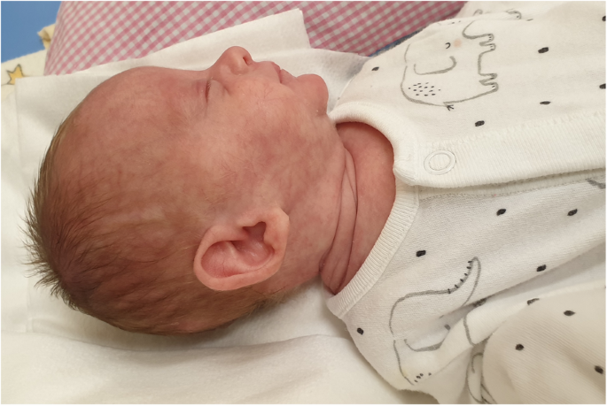
Notes:
Coarctation is 8 times as frequent when turner is associated with webbing of neck.
Noonan is rarely associated with coarctation

Slide 39
Notes:
2 method for upper and lower limb measurement
Femoral and radial
Femoral and brachial
In infant and newborn, brachial is better palpated than neonates
Normally radial and femoral are synchronous,so any delay is abnormal
Brachial and femoral, 15msec in adult and less of delay in neonate is normal
Slight deviation can hence be judged.

Slide 40
UL BP>> LL BP
L UL BP>> R UL &LL BP
R UL BP>> L UL&LL BP
Notes:
Usual location is juxta ductal, just distal to origin of left subclavian artery
Bp difference
One condition where all 4 limb bp is low. Coarctation compramising left subclavian artery and with abberant rsa arise distal to coarctation

Slide 41
Notes:
What is perceived as abnormal delay in femoral pulse is not a delay in arrival time but a slow rate of rise to delayed peak
Systolic bp difference persist and not diastolic bp usually
Care to be taken when associated Aortic regurgitation, it reinforces femoral pulse

Slide 42
Notes:
Undersized and oversized cough shows difference of approximately 10-30mmhg
Width – 40% of circumference of arm
Length-sufficient to encircle the limb
Lower extremity –popliteal artery is best
Difference between arm and leg systolic pressure is exaggerated by excercise

Slide 43
Delayed
Less than 2.5mm
Heard posteriorly over thoracic spine
Cresendo Decresendo
Delayed in onset and termination
Disappear on compression
Notes:
In sick infants with pulmonary htn, s2 single and loud- summation of a2 and p2
Loud s3 gallop is present
Heart failure causes coarctation murmur to decrease
Non specific ejection systolic murmus is audible over the precordium
Heart murmur may become audible after treatment

Slide 44
Notes:
Cork screw retinal arterioles in adults

Slide 45
ECG
Notes:
In symptomatic neonates, rad with rvh-
Right atrial abnormality- tall p waves

Slide 46
Notes:
Adults-tall r and low,flat or inverted t waves

Slide 47
Notes:
Coexsiting bicuspid aortic stenosis will show lvh strain pattern

Slide 49
Notes:
Symptomatic infant
Pvh
Dilated RA, RV, LA due to patent Foramen ovale causing left to right shunt
Lv not much dilated

Slide 50
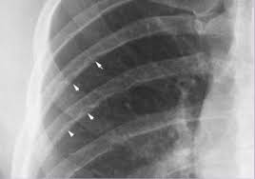
Notes:
Rib notching posterior intercoastal artery passign through intercostal groove.
Seldom appear before 6 years, reports are available for 2 years with rib notching

Slide 53
Notes:
purely high velocity and pressure gradient are not reliable because they can be misleadingly low in
impaired cardiac function or spuriously high with high heart rate or associated aortic stenosis. A pressure gradient that persists
into diastole is an indicator of severe stenosis. This is also known
as diastolic tail, which can be confused with a persistent ductus
shunting left to right.
Delayed rate of systolic upstroke and diastolic flow in abdominal aorta may hint presence of coarctation

Slide 54
Notes:
Cardiac mri with gadolinium contrast is modality of choice

Slide 55
Treatment
SYMPTOMATIC NEONATES
Start PGE1
Inotropes
Monitor Urine Output
NPO- Reduce risk of NEC
0.05-0.1 mcg/kg/min
0.2mcg/kg/min
It is helpful to maintain ductal patency whenever possible.
WHAT TO AVOID?
Avoid hyperventilation and high FiO2 .
Vasodilators should also be avoided.
Notes:
it can take between 15 minutes and 4
hours to re-establish forward circulation
Once patient is stablizied proceed with sx or non surgical measure for treatment of coarctation

Slide 56
Side effects of PGE1
Apnea
Cutaneous Vasodilation
Hypotension
Fever
Increased Infection
Metabolic derangements
Necrotizing enterocolitis
Notes:
Longer infusion period,high doses and poor gc of baby
It is better to decrease the dose to 0.01-0.02 mcg/kg/min as soon as the desired effect has been achieved

Slide 57
Mechanical ventilation
VSD+COA -Lowered FiO2 to Maintain Spo2-85%
(avoid Drop in PVR) And Qp : Qs =1:1
Acidosis(0.5-1 Meq/kg HCO3) and electrolyte balance corrected
Cautious correction of Hypotension → attributed to obstruction and LV failure rather than hypovolemia
Notes:
Persisitent acidosis- indicating ongoing disease

Slide 58
Fluid loss from Capillary leak
Systemic Vasodilation after PGE1
Responding to PgE1→ Fluid restriction ( 70-80% of Maint.Fluid )
Isotonic fluid (5ml/kg/ D)
Still in shock
Lv dysfunction- Low dose Inotropes
Notes:
Low dose dopamine- 5-7 mcg/kg/min
After they are metabolically active→ we can proceed with surgery
Nicardipine – 1st line of BP drug management during surgery

Slide 59
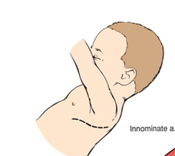
TREATMENT
Non surgical
Surgical
Balloon angioplasty as palliative procedure
High rate of re-coarctation and complication – femoral artery injury
CHF/ Circulatory shock
CoA+ Non Restrictive VSD repair(etc)
Notes:
Surgery is preferred in most centres after stabilization
Left lateral thorocatomy approach
Midline approach if associated with other cardiac anomaly

Slide 60
Extented
End to End anastomosis
Subclavian Flap technique
Patch Aortoplasty
Notes:
Subclavian flap technique- part of tissue from left subclavian artery is taken. Left ul will be supplied by collateral artery. As a result left ul will be looking smaller
1)Left lateral thoracotomy approach
Post op renal failure / recoarctation is se

Slide 61
SUBCLAVIAN FLAP
TECHNIQUE
EXTENTED END TO END ANASTOMOSIS
Patch Aortoplasty
1) Remove all the Hypoplastic component of aortic arch
2) Reduced incidence of
Re-coarctation
1)Risk of aneurysm in segment opposite to Graft
1) Compromise Subclavian artery
2) Higher chance of re-coarctation because some hypoplastic tissue are left behind
3) Cerebral ischemia because of steal phenomenon
Notes:
Htn may persist after coarctation

Slide 62
Surgical complications
Notes:
Spinal cord ischemia

Slide 63
CoA + VSD
CoA repair + Pulmonary Banding
Pulmonary Debanding f/b VSD closure
Single Stage repair via Median sternotomy approach
High Risk of neurological complication if the procedure is carried in Deep hypothermic circulatory arrest

Slide 64
Re-coarctation develops
Incomplete Initial repair
Residual abnormal tissue that may proliferate
Failure of anastomotic site to grow
Thrombus formation at suture site
Intimal and medial hyperplasia at suture site
Balloon angioplasty with possible stent placement
Notes:
Stent is usually avoided because it is difficult to dilate to adult arch dimensions later
Rarely surgery with prosthetic patch enlargement of the stenotic site or bypass of segment with tubular graft

Slide 65
INTERUPTTED AORTIC ARCH
Presence of Discontinuity anywhere along the Aortic arch
Mechanism: 1) Abnormal involution of 3rd and 4th Arch & neural crest migration
2) Teratogenic exposure to Bis-dichoroacetyl amine and Isotretinon
Notes:
Military casuality agent
Treating acne
Associated with digeorge syndrome
Iaa is a rare anomaly
But in digeorge syndrome it is a common association

Slide 66
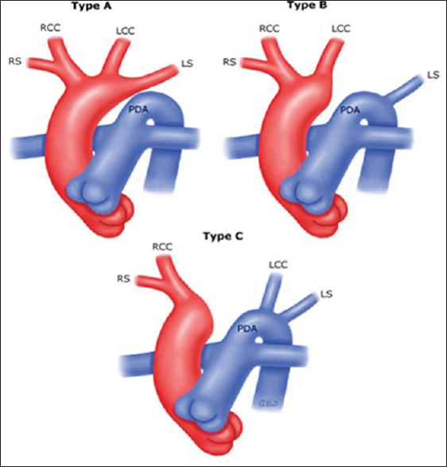
CELORIA AND PATTON CLASSIFICATION
Notes:
Presentation similar to coarctation
Type C- antegrade flow in RCC and retrograde in LCC
Any patient with Type B IAA→ should go genetic screening for 22q11.22 chromosomal deletion

Slide 67
Notes:
Given the common association of iaa with digeorge. Every pt with iaa should be seen for Digeorge stigmata
Broad nasal bridge, malar hypoplasia hypertelorism, low set posteriorly rotated ears, retrognathaia, submucosal cleft palate,small mouth
Associated t cell deficiency and hypocalcemia

Slide 68
NEVER AN ISOLATED ANOMALY
Always associated with VSD and PDA
If no VSD
Search for AP window
Notes:
Upper part of body from LV Lower part of body via PDA
Vsd and Pda are coexisting anomaly
Posteriorly malaligned VSD is a rule when it is type B
When Ventricular septum is intact(50%), Equivalent AP window is present- type a

Slide 70
No differential cyanosis -Because of O2 rich blood from VSD With left to right shunting
However pulse oximetry may show higher o2 saturation in upper arm compared to lower arm
IAA with TGA will show reverse differential cyanosis

Slide 71
Notes:
Aortic valve is Bicuspid with varying degree of Commisural fusion and Annular Hypoplasia

Slide 72
PRESENTATION
SIMILAR TO Neonatal COARCTATION + VSD
Notes:
Mean survival Time- 4-10days
Worsens when duct closes
Sudden increase in pulmonary blood flow and no flow to lower limb-shock , acidosis and renal failure

Slide 73
Clinical signs
Reduction in Femoral pulse → Ductal constriction
Isolated RV impulse →Obligatory PHT, VSD and PDA
Flow through Duct → Silent
Continous murmur → Collateral
VSD →Early Systolic murmur
PTHN
Generalized cyanosis
Notes:
Initially no pulse difference
3) Single non restrictive arterial conduit formed by the continuity of pulmonary trunk, ductus and descending aorta

Slide 74
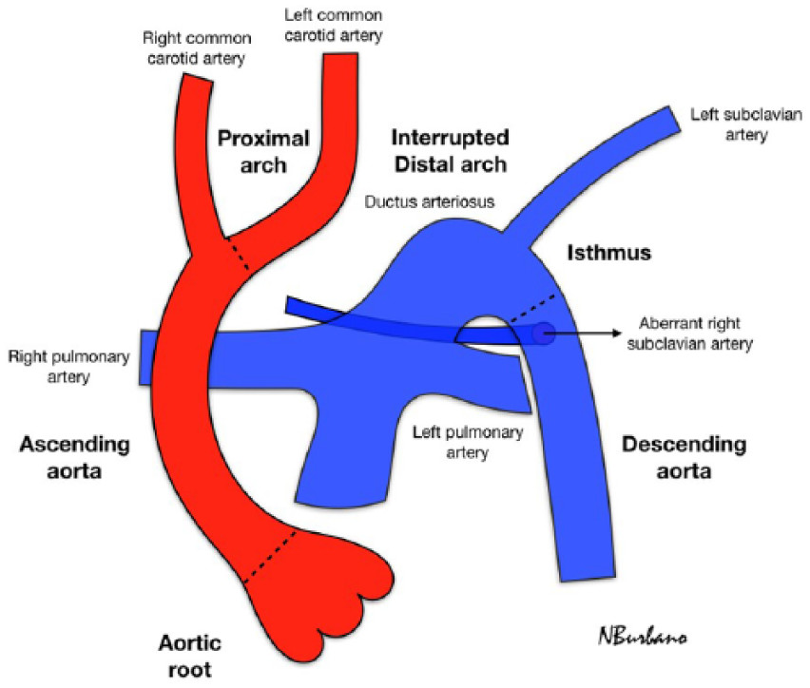
Notes:
All 4 limb pulse are weak, and both carotid are bounding
No vsd/pda→ wide spread collaterals prominent, esp. Head behind the ears

Slide 75
Notes:
RAE,RVH IN INFANT,LVH IN OLDER PT
BIVENTRICULAR HYPERTROPHY ALSO CAN OCCUR –PRESSURE OVERLOAD TO LV

Slide 76
Notes:
A)Prominent pulmonary trunk and venous congestion. Inconspicious Asc. Aorta. Right atrium is enlarged. Trachea usually in midline. Not deviated by aortic arch
b)LAO both right and left ventricle is enlarged

Slide 77
ECHO
Notes:
Discrepency between small calibre of ascending aorta and conspicuous dilation of Pulmonary trunk
If No vsd, search for ap window
Image created by continuity of pulm trunk, ductus, descending aorto- resemble aortic arch

Slide 78
Pre Operative assessment
Failure to Identify and correct Significant LVOT obstruction may result in heart failure post operative
Hypocalcemia common finding – even in pts without Di-George
Irradiated blood product – as Pt has T cell deficiency
Risk of Symptomatic Hypocalcemia during hyperventilation and transfusion of citrated blood product
Notes:
4) To prevent graft vs host reaction

Slide 79
Management
PG E1 Infusion
Inotropes/Mechanical ventilation
NPO

Slide 80
Single Repair
Arterial duct ligated,
Aorta mobilized,
Descending aorta directly anastomosed with Ascending Aorta (Homograft/Pericardial Graft tissue)
Correct ASD/VSD
Correcting LVOT obstruction due to Posteriorly Mal-aligned VSD
Notes:
Done on 1st 5-10 days of life
2 Staged repair if child has other extracardiac anomaly associated
Aortic arch repair and palliation like pulmonary artery banding at first
Then removing pulmonary band and procedure like vsd closure.

Slide 82
CRITICAL AORTIC STENOSIS
Definition
Peak systolic gradient > 80mm Hg
Mean Systolic gradient > 60mm Hg
Valve Area < 0.5cm2/m2

Slide 83
Severe Aortic stenosis
Critical Aortic stenosis
Loud systolic Murmur
Not very symptomatic (Benign course)
No significant Murmur
Emergent situation
Intractable CHF in neonates
Infarction of papillary muscle causing MR

Slide 84
SEVERE STENOSIS
LIMITATION OF FLOW THROUGH LEFT VENTRICLE
INCREASED LV AND LA PRESSURE
HIGH INTRACAVITATY PRESSURE
LV WALL THICK
CAVITY HYPOPLASTIC
SMALL AORTIC ANNULUS AND ASCENDING AORTA
LEFT TO RIGHT SHUNT ACROSS PFO
REDUCED CORONARY PERFUSION
RV VOLUME OVERLOAD
SUB ENDOCARDIAL ISCHEMIA
Notes:
FLOW ACROSS LV IS LOW → NO MURMUR

Slide 85
Pathology
Notes:
Usually unicuspid aortic valve(60-80%), though some other studies showed Bicuspid also predominant
Aortic annulus is small , so as mitral valve and left ventricular cavity and arch.
LV cavity -> small . Associated HLHS, endocardial fibroelastosis LV cavity-> dilated, secondary to ischemic MR

Slide 86
Clinical features
During fetal Life : No Significant hemodynamic change – Aortic Flow maintained By Ductus
Patient symptomatic within few hours / Day of life as Ductus close
Pulse low volume
Patient in Shock

Slide 87
MANAGEMENT
PGE1 infusion
Inotropes
Severe LVOTO
Decreased LV function
Inadequate Mitral valve size
Absence of Atrial communication
BALLOON ATRIAL SEPTOSTOMY
ECM0
Notes:
3) RAPID DETORIATION

Slide 88
LEFT VENTRICLE –CAN SUPPORT SYSTEMIC CIRUCLATION
LEFT VENTRICLE –CAN HYPOPLASTIC
SINGLE VENTRICLE PALLIATION
TWO VENTRICULAR REPAIR
Notes:
Most critical part is knowing whether left heart will support Systemic circulation after repair

Slide 89
Notes:
3 YRS OLD HAD CRICITAL AS, BALLOON DONE VIA TRANSATRIAL APPROACH DUE TO AVOID POTENTIAL ARTERIAL COMPROMISE, ENSURE BALLOON IS THROUGH HAEMODYANAMIC ORIFICE.
NOTE IN LAST SEQUENCE REVERSAL OF DUCT FLOW COINCIDE WITH IMPROVE,MENT OF LV FUNCTION
Good dilatation reduces peak systolic gradient by 20-35mm Hg

Slide 90
PERCUTANEOUS BALLOON VALVULOPLASTY
Initial procedure of choice in most centres
Balloon chosen → 80-90% of diameter of annulus
Balloon Is positioned such that half or more of its length below annulus
Vascular access → Venous (umblical / Femoral Vein)
Arterial-> Carotid/ Femoral
Notes:
During balloon inflation observation of tight waist is important
Iatrogenic ar and arterial access injury is a well known complication
Previously it was surgical valvotomy was choice

Slide 92
Notes:
Transaortic surgical valvotomy
Precised opening of congenitally stenotic aortic valve
Opening fused portion by commissurotomy

Slide 93
Hypoplastic left heart syndrome
Turner syndrome
Noonan syndrome
Holt oram syndrome
Notes:
Varying degree of underdevelopment of left heart structures- hypoplasia atresia stenosis of aortic valve , mitral valve, hypoplasia of lv and ascending aorta
Most common cause of death of chd in 1st week
Brain is smaller than normal
Needs mri brain for screening of neurodevelopment anomaly screening

Slide 94
Notes:
The lv is small,arch hypoplastic flow is retrograde via ductus
There is lv inflow without outflow. As a result lv is hypertensive and hypertrophy and endocardial fibroelastosis. The lv mass is increased causing distortion of inflow of rv. Resulting in tr.
The left ventricle is small but antegrade flow through aorta occurs

Slide 95
Notes:
Underdeveloped left av valve- associated with abnormalities of atrial septum like pfo, secundum and primum asd and aneurysm of septum primum
Surgeon should be aware while doing atrial septectomy
10% has intact atrial septum. Alternate pathway for la drainage include, anamolous pv to systemic vein,persistent left svc from la, unroofed coronary sinus communicating with la

Slide 96
CORONARIES IN HLHS
Hypoplastic Ascending Aorta act as a common coronary artery- Receiving Retrograde flow from the ductus
Ventriculo coronary flow –Myocardial sinusoids : L V cavity → Coronary artery

Slide 97
During Fetal Life
PVR >> SVR
Dominant RV perfuses Aorta via ductal Right to Left shunt

Slide 98
After birth
Decreased PVR
Closure Of Ductus arteriosus
Shock
Notes:
Flow from Pa to aorta reduced

Slide 99
Increased PBF
Increased Left atrial Blood
ASD
RESTRICTIVE
NON - RESTRICTIVE
Poor mixing of arterial Blood in RA
Low Saturation
More Pulmonary vein congestion
Good mixing of arterial Blood in RA
Better Saturation
Less Pulmonary vein congestion

Slide 100
SURVIVAL DEPENDS ON
Ductal Patency
PVR
Inter atrial communication
Notes:
Normal at birth
Worsens after 48 hours or after discharge

Slide 101
Clinical presentation
Heart failure
Cyanosis – Depending on Interatrial communicaton
Severe Manifestation after duct closes
Left Sided Obstruction → Pulmonary congestion
Week Peripheral pulse → Shock
Severe cyanosis
Notes:
After birth PVR falls, all blood shunted to Right side, Right heart failure ensues.
Pulmonary congestion- tachycardia, tachypnea and respiratory distress

Slide 102
Clinical finding
Dominant RV impulse
S1 normal, loud P2 (No A2)
CHF- Enlarged Liver, Basal creps
Notes:
TR murmur
ESM due to flow across dilated pulmonary artery

Slide 103
ECG
Always → RVH
Rarely large R waves in V5 and V6
Because these leads are placed in Enlarged RV and Not hypoplastic LV
Notes:
Wpw is rare though there is persistent connetion of the left bundle branch to ventricular septal musculature with abundant mahaim fibres

Slide 104
Notes:
Large RA with absent ascending aortic shadow may give a reverse of 5 appearance

Slide 105
ECHO
Small Muscle Bound LV that does not extend to cardiac apex
Endocardial border is Hyper echoic → Endocardial fibroelastosis
Left atrium is small → Dilated in Restrictive ASD
Hypoplastic Arch / Atretitic Mitral and Aortic valve
Notes:
Left ventricular cross sectional area < 1.5cm2
Mitral annulus < 6 mm
Ventricular end diastolic inflow dimension less than <25mm

Slide 106
Notes:
Plax
lV is small and muscle bound
Endocardial surface is Hyperechoic due to efe

Slide 107
Notes:
Psax: right ventricle and small hypertrophied left ventricle
Larger mpa and pda are connecting descending aorta
No brachiocephalic vessels are seen arising from ductal arch; key differenting feature from true aortic arch

Slide 108
Notes:
La and lv is much smaller than ra and rv
The right ventricle occupies the cardiac apex

Slide 109
Notes:
Colour doppler in transverse arch show retrograde flow from pda to aorta

Slide 110
Staged repair for HLHS
Stage I – Norwood Procedure
Atrial septectomy to ensure unobstructed pulmonary blood flow
Un-Obstructed association of right ventricle with aorta
Systemic to Pulmonary shunt ( either through Modified BT shunt or Sano shunt)
1st week of life
Notes:
Medical management is same” Balloon atrial septostomy in case of restrictive pfo
Cardiac cath and angiography are mandatory before any surgical procedure
to limit Pulmonary blood flow and attenuate pulmonary vascular changes to excessive flow
The work load of rv is now high

Slide 111
Notes:
Small dose diuretic
Ace inhibitor to reduce after load for systemic rv
Aspirin to prevent shunt thrombosis

Slide 112
Staged repair for HLHS
Stage 2 – Bidirectional Glenn or Hemifontan
Stage 3- Fontan circulation
3-6 months of life
2-4 years of age
Notes:
to limit Pulmonary blood flow and attenuate pulmonary vascular changes to excessive flow
The work load of rv is now high

Slide 113
Notes:
Hemi fontan – side to side anastomosis of svc to right pa without disconnecting from rt atria. Atrial side is sutured
glenn end to side anastomosis of svc to right pa

Slide 114
Notes:
Bidirectional glenn- svc to right pulmonary artery anastomosis. 3-6 months of life as pvr is low and passive flow of blood in pulmonary ciruculaton takes place

Slide 115
Notes:
Significant tr and elevated mean pa pressure poor prognosis

Slide 116
Hybrid approach
Notes:
Certain pt with high risk, single ventricle , candidate for cardiac transplant
Perform hydrid and proceed with fontan type surgery or cardiac transplant

Slide 117
Cardiac transplant
Keep ductus open
Increase size of inter atrial communication
Better when ascending aorta less than 2.5mm
Notes:
In 1985 and first successful transplant done by boston in 1985

Slide 118
Thank you

